Slide 1
Introduction to Recording and Editing Audio with Audacity
By Mel Williams and Ayah Aboelela
Digital Integration Teaching Initiative (DITI)
AFCS1113: Black Popular Culture
Dr. N. Fedeke Castor
Spring 2025
Feel free to ask questions at any point during the presentation!

Slide 2
Objectives
Understand podcast anatomy
Discuss how podcasting relates to embodiment and inclusion
Learn best practices for audio recording
Learn about and explore Audacity as a podcast editing tool
Learn how to:
Record, import, and clip audio
Add, move, and delete tracks
Add sound effects and/or background music
Save and export projects
Slides and handouts available at: XXX

Slide 3
Podcast Anatomy

Slide 4
Podcasts
Podcasts typically begin with an opening segment of 10–30 seconds of music and audio wherein the creator identifies the podcast title, host, and episode topic—this creates a trademark/signature and indicates to the listener that the podcast is about to begin. Be as creative as you want!

Slide 5
Podcast Anatomy: Intro/Opening Segment
Intros/Opening segments are listeners’ first impressions of a podcast. From the opening segment alone, listeners make assumptions about the podcast’s Audience, Genre, Style, and overall Structure.
This means that within a short span of time, the podcast’s opening segment must accomplish several goals like:
Grabbing attention: several successful podcasts set the tone using Media (e.g., theme song music, sound effects, archival audio clips)
Identifying an audience: acknowledging/naming people who might be interested
Establishing listener expectations: explaining the goal and theme of the podcast
Notes:
Consider the emotions and perceptions sounds evoke in listeners when choosing music and sound effects for your intro (spooky violins, dramatic horns, happy guitars, etc.)

Slide 6
Discussion: Opening Segment Example
Listen to the opening segment (0:00-1:20) “Episode 402: You Don’t Know African Diasporic Religions” of Keeping It 101: A Killjoy’s Introduction to Religion Podcast.
What audio techniques do they use to engage their audience?
What additional opening statements are made, and what are their purpose?
How is the topic and/or speakers introduced?

Slide 7
Podcast Anatomy: The Body
Your podcast should have an argument or perspective, not just a recitation of facts. Try to keep your tone persuasive and conversational. Like any good piece of reporting, your podcast should be organized and rehearsed ahead of time. Do your research and have your script written before you start recording; know how your show is laid out and how much time you have.
Write out large numbers and/or complicated words/names out phonetically (twenty-two thousand and thirty-four vs. 22,034)
Mark out spaces in the script for pauses, sound clips/effects, transitions between topics, etc.

Slide 8
Discussion: The Body Example
Listen to a portion of the body (20:24-23:10) of “Episode 402: You Don’t Know African Diasporic Religions” of Keeping It 101: A Killjoy’s Introduction to Religion Podcast.
What audio techniques are used to move from one topic/speaker to another?
How is context or additional information provided to the listener?

Slide 9
Podcast Anatomy: The Outro
Podcasts typically end with a closing segment of 10–30 seconds of music and audio acknowledging the creator names the creator(s), institutional affiliation, and audio/production credits, and acknowledgments including people whose work or advice has significantly influenced or contributed to the episode.
An outro script for your class might sound something like “This podcast was made by [student name]...opening music created by [artist name], sound effects taken from [repository name]... with special thanks to [name] for their contribution.” It may also include outro music.
As in your opening segment, you can use music and sound effects to make your closing segment dynamic and interesting.

Slide 10
Discussion: The Outro Example
Listen to a portion of the body (46:24-48:10) of “Episode 402: You Don’t Know African Diasporic Religions” of Keeping It 101: A Killjoy’s Introduction to Religion Podcast.
What outro techniques does this podcast include, and how do they affect your understanding/perception of the material?
What about the outro media?

Slide 11
Best Practices for Podcasting

Slide 12
General Best Practices
Test your mic and technology before you start.
Record some test audio and play it back before you begin.
Have a plan for the conversation and transitions.
Give yourself a script. As you record, mark out spaces for transitions in the recording (topic-to-topic, parts of the episode).
Don’t panic over filler words (e.g., um, uh, yeah, like). Edit these out later.
Prepare phonetic pronunciations for names, long numbers, and complicated terminology.
Include transcripts for accessibility (use software like Otter AI).
Use open access media/music (BBC Sound Effects, Incompetech).

Slide 13
Environmental Considerations
Ideally, find a room with good sound absorption to prevent the “echo effect”
Yes: carpet, cushions, bookshelves, clothes (bedrooms, closets)
No: larger spaces with hard, smooth surfaces (kitchens, bathrooms)
Consider: Does the room have an echo? Hard floors/countertops/stainless steel surfaces?
Put some distance between yourself and the microphone (depending on your equipment).
Being too close can make the audio too loud or garbled sound as you speak. If you are positioned too far away the audio will be too quiet or too muffled to salvage.
Stay hydrated!
Keep a drink nearby (water, juice, etc.) to soothe your throat and keep it relaxed.
Notes:
Carpets, Curtains, and furniture (like full bookshelves) are great for sound absorption.
Typically, you can save some audio that’s too loud. It’s more difficult to save audio that’s too quiet. But the best practice is to find a position that feels comfortable for you! Practice recording a phrase at different distances and play it back to help find the right position.

Slide 14
Recording Considerations for Interviews
Remote Recording (via Skype, Zoom).
If you record via Zoom, save your recording to your computer not the cloud.
Ease in to recording with low-stakes conversation
Interviews are like playing catch. Start with questions that allow everyone to get comfortable. Be yourself!
Don’t rush, and know you can start over
You don’t need to get everything in a single take, and you won’t use all the audio that you record. So don’t be afraid to pause frequently and remember you can start over (or cut something altogether!)

Slide 15
Recording From a Phone
Smartphones have become a very common way to record interview audio. Even professional journalists now primarily use their smartphones.
Depending on the phone you have, the app you use will be different—any app that can record audio will work. These free apps are a good starting place:
Recorder (Google LLC) for Pixel phones
Voice Memos (Apple) for iPhones
Samsung Voice Recorder (Samsung) for Galaxy

Slide 16
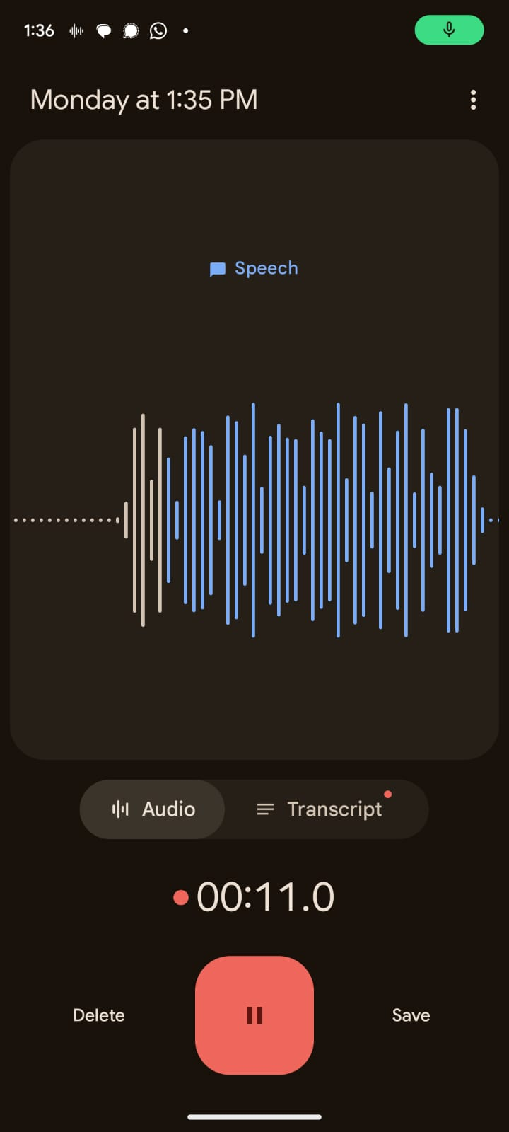
Using Audio Recording Apps
These apps universally use a big, red button to start recording. This slide shows Google’s Recorder app, but all of these buttons will be very similar regardless of the app you are using.
If you want to take a short break in your recording you can hit pause (highlighted in green). This will stop the recording until you hit record again, but it won’t end the recording as a whole.
To get to the pause button in Apple Voice Memos, swipe up on the recording while it’s running.
Finally, when you’re done recording remember to hit save or stop (often represented by a square) depending on your app. This will end the recording altogether and let you send it to your computer.
Be mindful of how your data and the recorded audio is stored on different recording apps.

Slide 17
Monitoring Your Recording
While you are recording, the app will show a waveform (highlighted in red), which shows the current audio input
Make sure to check your waveform intermittently as you record (especially at the beginning)
If you aren’t seeing any waveform or it is very small, the phone is likely not picking up your audio
The peaks and troughs of the wave show when it is picking up more and less audio. This should generally match the louder and quieter parts of your interview recording, though don’t worry if it doesn’t seem to be completely precise.

Slide 18
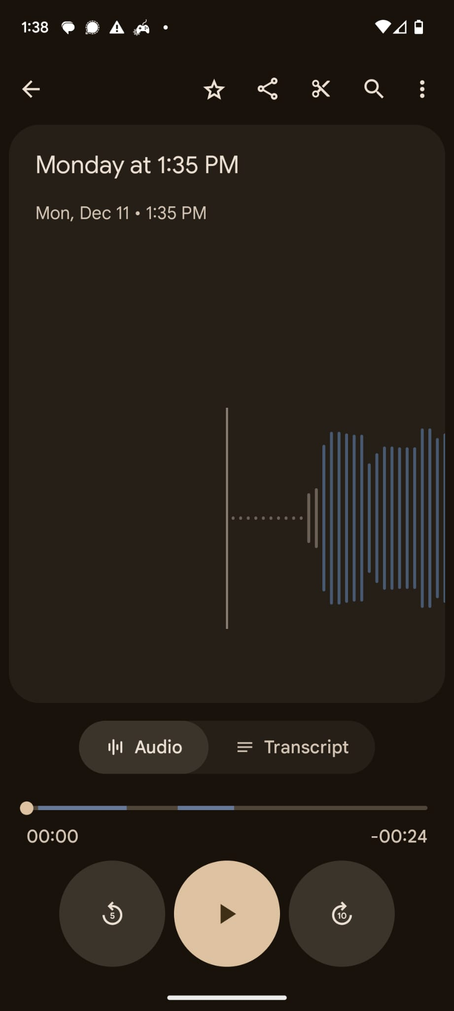
Getting the Audio From Your Android
The easiest way to get the file from your phone to your computer will be to use the share function. Look for a symbol like the one highlighted on the right.
From the share menu, you will be able to send the file to yourself in various forms, such as email.
Sometimes the file size may exceed the limit for email, which is where Google Drive can work better
As soon as you have files on your computer, you can move on to audio editing!

Slide 19
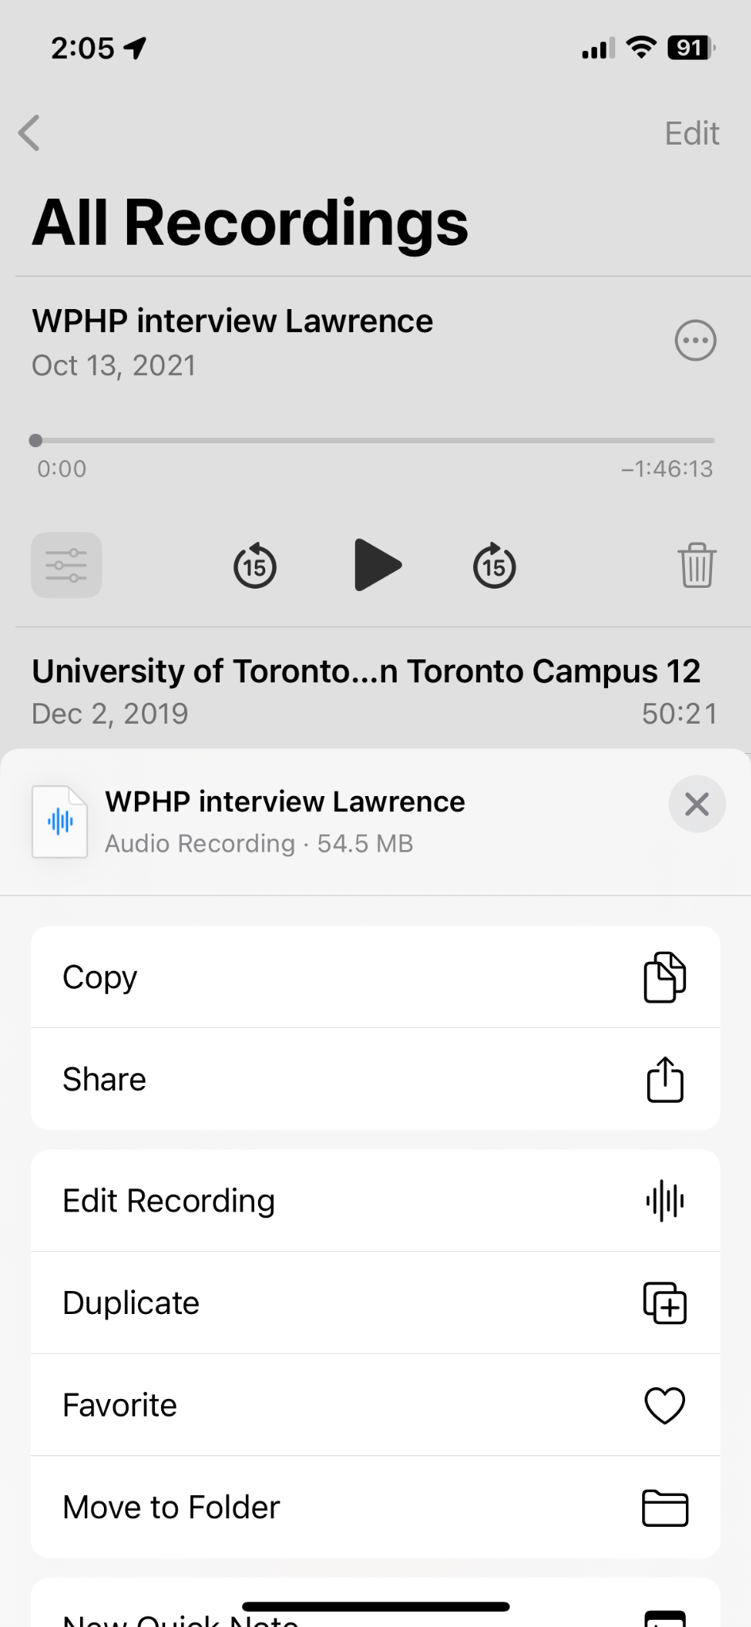
Getting Audio From Your iPhone
To get audio out of Voice Memos, click the three dots (highlighted in red) and select “share” (highlighted in green).
You’ll need to pick a method that works for you:
Airdrop and iCloud work.
If you download the app for Drive or Dropbox (or similar), you can send the file to those.
It will probably be too big a file to email to yourself.

Slide 20
Making Podcasts: Audacity

Slide 21
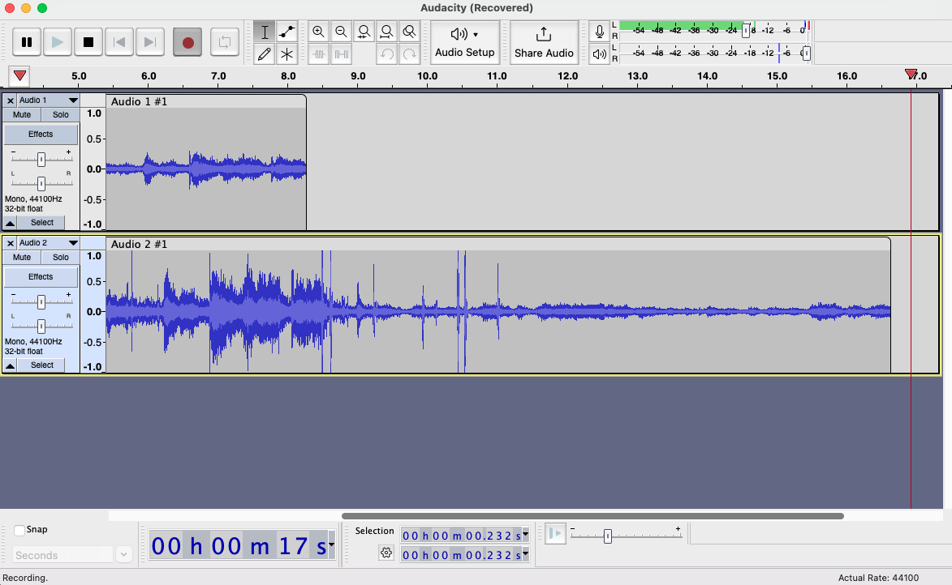


What is Audacity?
Audacity is a free, easy-to-use, multi-track audio editor and one of the more popular free audio editors used for creating podcasts.
(Multi-track: the ability to have different layers of audio in one clip.)

Slide 22
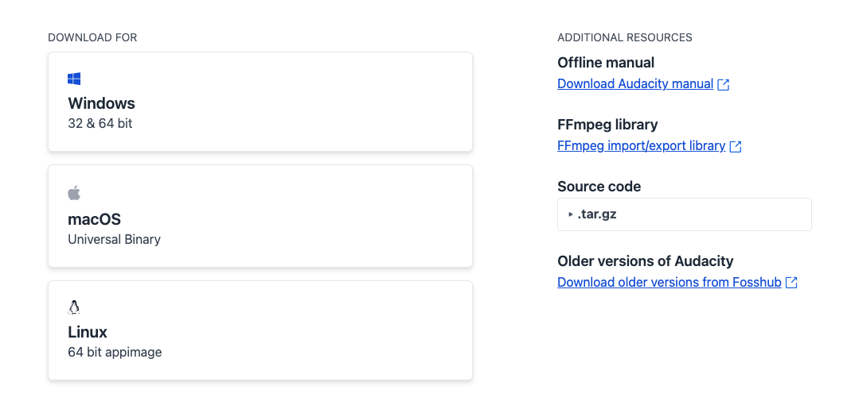
Downloading Audacity
https://www.audacityteam.org/download/

Slide 23
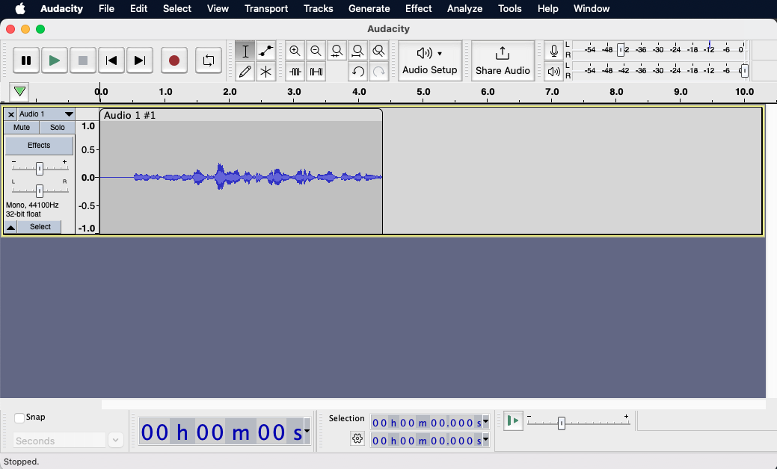
Anatomy of Audacity
Audio Editing
Main buttons (L-R): pause, play, stop, fast-forward/
backward, record
Microphone, volume, input, and output
Recordings (audio tracks) will display in this window here.
Editing, saving, effects, transporting or exporting the recording.
Output Volume Level Monitor: shows the loudness of each track in real-time
https://manual.audacityteam.org/

Slide 24
Key Terms
Track: a single audio channel or stream.
Multi-track: an audio recording or chanel with more than one track or recording of sound.
Clipping: splitting audio into separate sections—that is, making “clips”
Waveform: the curve within a track showing the duration and volume of individual sounds
Mixing: the process of audio production, or mixing tracks of recordings, music, and other desired media.
MP3 File: the most generally used audio file format. Others include .wav and .mp4.
Feel free to ask questions at any point during the presentation!

Slide 25
Basics: Audacity & Recording Audio

Slide 26
Getting Started: Tips for Recording Audio
Know where your microphone is located and keep it clear of papers/other objects
Use headphones when recording and editing
After you finish editing, listen to the file without headphones to see where the audio is too loud/quiet when played in a space.
Take ambient noise into consideration
A/C units, refrigerators, traffic, pets, roommates, loud clothing, etc.
Save frequently. Audacity does not autosave.
Notes:
After you finish recording, listen to the audio with and without headphones so that you can properly render the sound. Audio sounds different in an open spaces than it sounds inside your headphones.

Slide 27
Recording Audio cont’d.
Record test audio and adjust mic volume if necessary
Record a few seconds of silence at the start and end of each track
Begin way in advance, and do several takes
Editing often takes much longer than the recording itself!
Speak slowly, clearly, and conversationally
If you use too many “filler words” (um, like, so) you can always edit them out later. Stop recording and start again at the top of the sentence to avoid jarring sound cuts in post-production
Notes:
Don’t be afraid to stop and start over if you mess up! You’ll save more time in the long run. You can pause between questions and give yourself a few seconds of silence to supplement your editing process.

Slide 28

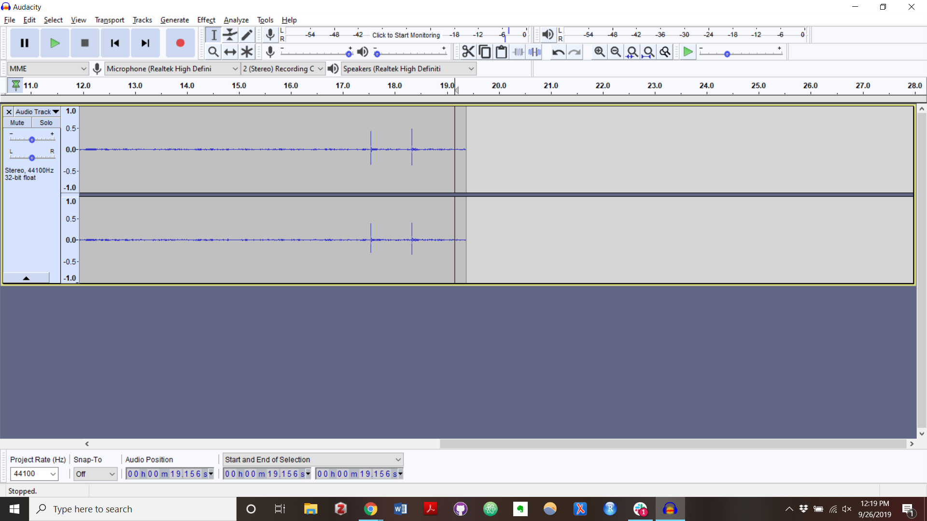

Recording
Make sure your microphone is working by checking to see that it’s selected in the microphone section of the screen. Each computer will have different microphones, so check your sound settings for your model.
To record, click the button with the red circle.
Hit the pause button to pause a recording.
Hit the stop button to stop recording.
Use Re-play to verify that the recording is the quality/ volume that you want.
Feel free to ask questions at any point during the presentation!

Slide 29
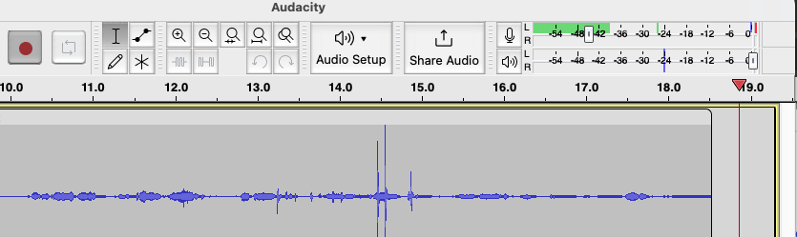
Checking volume
Keep an eye on the monitor when recording and playing back your audio—try to keep it in the green (literally).
If your volume is too loud, the monitor levels will turn yellow and red. Tracks that are too loud will have a blown-out effect when played back.
If one of your tracks is louder or softer than the others, you can adjust the volume on each track.
Tip: to hear one track without the others, you can mute the other tracks or click “solo”
Feel free to ask questions at any point during the presentation!
Notes:
You do want to be in the upper range of the green, ideally almost yellow. Anything less will be extremely quiet compared with other audio you listen to on your computer.

Slide 30


Adjusting Mic Volume
If the recording volume is too loud, you can use the slider in the recording meter to adjust the recording level
Move the slider to the right for a higher (louder) recording level and to the left for a lower quieter) recording level
Feel free to ask questions at any point during the presentation!
Notes:
You do want to be in the upper range of the green, ideally almost yellow. Anything less will be extremely quiet compared with other audio you listen to on your computer.

Slide 31
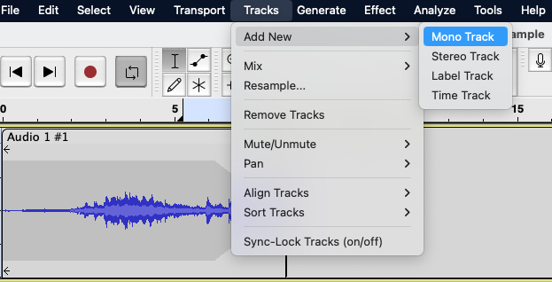
Adding Tracks
To create additional tracks in Audacity for a new recording, hit the record button and it will start a new track. Another option is:
Navigate to the Tracks menu option and select Add New. This will open a list of options. Select the Mono Track option.
Feel free to ask questions at any point during the presentation!

Slide 32
Basics: Audacity & Editing Audio

Slide 33

Toolbar: Selection and Multitool
The selection tool will be selected automatically when you open Audacity.
The multitool allows you to use all the functions of the other tools without switching to them.
The selection tool function is the default.
Hover over the waveform borders to use the envelope tool function.
Use your trackpad to zoom.
Zoom in and left click to use the draw tool function.
Feel free to ask questions at any point during the presentation!

Slide 34
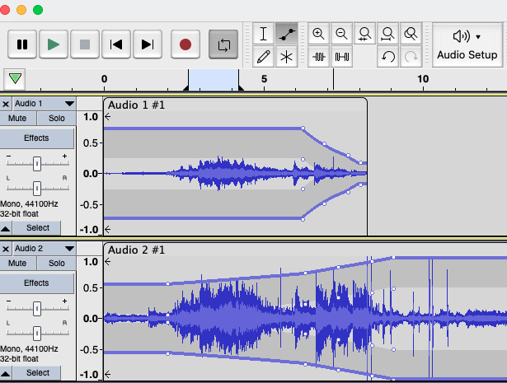
Toolbar: Envelope
The envelope tool allows you to smooth changes in volume by using control points at the top and bottom of the waveform.
Clicking on the blue border will create control points, which you can then move around to adjust the waveform envelope.
Feel free to ask questions at any point during the presentation!

Slide 35
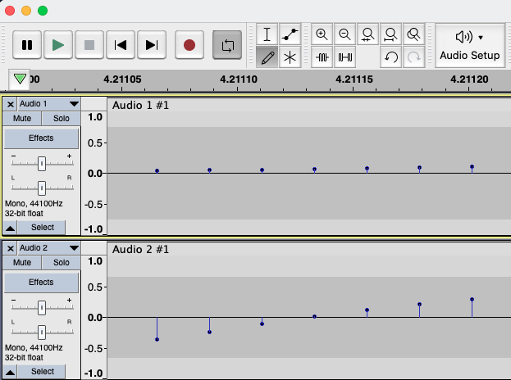
Toolbar: Zoom and Draw
The zoom tools let you zoom in and out of the waveform in order to make adjustments.
The draw tool allows you to manually redraw the waveform to change the volume or correct background noise.
You can only use the draw tool if you’ve zoomed into the waveform.
Feel free to ask questions at any point during the presentation!

Slide 36
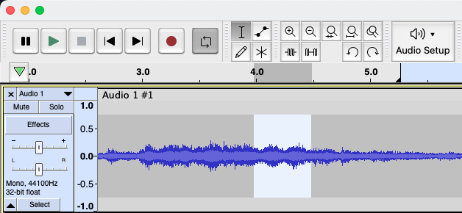
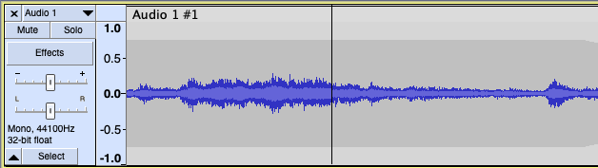
Removing Parts of Tracks
Once you have recorded audio in Audacity, you can easily edit it. Here is how to remove sections using the selection tool:
Click and drag with your cursor to select the portion your wish to remove.
Then, hit backspace or delete on your keyboard.
Tip: you can zoom in and out with the zoom tools to better see what you’re trying to delete.
Feel free to ask questions at any point during the presentation!

Slide 37
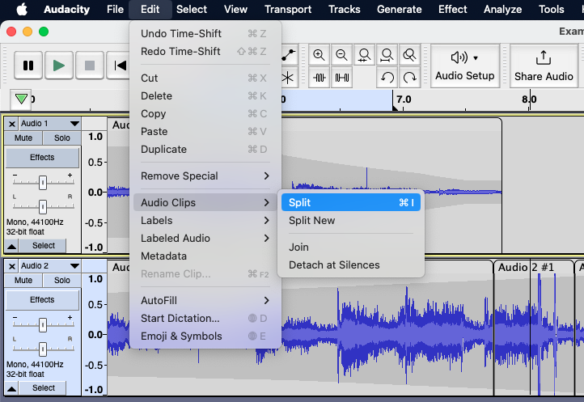
Splitting Tracks
To split a track in Audacity, follow these steps to make shorter clips:
With the selection tool, place your cursor over the section where you want to split your track.
Navigate to the Edit menu, click under Clip Boundaries and select Split.
Feel free to ask questions at any point during the presentation!

Slide 38
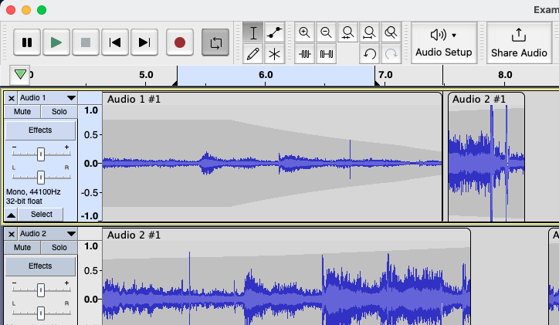
Moving Tracks
To move entire tracks or audio around in Audacity, you can click and drag them by hovering your mouse over the top of the clip.
Once you have selected the clip, click whatever clip or track you want to move and drag it into position.
Feel free to ask questions at any point during the presentation!

Slide 39
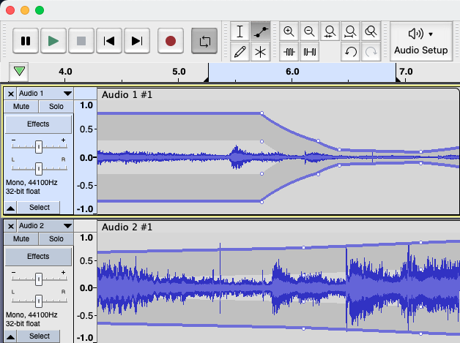
Fading In/Out
To fade music in and out on Audacity, use the envelope tool. Two yellow bars will show up on each track.
Click to add control points (little white dots) on the track you want to fade in.
Drag and move the nodes to up and down and side to side to change the volume and how gradual the volume fade is.
Add and adjust nodes at the end of the track to fade the music back in.
Feel free to ask questions at any point during the presentation!

Slide 40
Your Turn!
Visit one of the following:
BBC Sound Effects and click on ‘Browse All’
incompetech.com and click on ‘Royalty Free Music’
Download something you want to play around with and try to:
Remove some of your track
Choose a part to fade in or fade out
Split the track into multiple
Add a new track to your project

Slide 41
Saving, Exporting, and Sharing

Slide 42
Saving
Audacity does not auto-save! Save your recording, early and often!
Try and save after each major edit/input of a recording, just to be safe.
Save in multiple places. Always have backup.
File > Save Project > Save Project As> “Name of your podcast”
And once your project is saved...
File > Save Project > Save Project > [saves the updates to your file]
Feel free to ask questions at any point during the presentation!

Slide 43
About File Formats
Lossless Audio File Formats: better than or equal to CD-quality
WAV: uncompressed file, meaning huge file size. The best for editing raw audio files in Audacity.
AIFF: Apple’s alternative to WAV. Uncompressed, not widely used
*MP3/MP4: compressed audio file, ensures small file size. Best for exporting and distributing from Audacity.
Ogg Vorbis: Open-source alternative to MP3. Used in Spotify streaming
*Note: The DITI typically recommends you save files as mp3 (sometimes mp4, if you use a PC).
Feel free to ask questions at any point during the presentation!

Slide 44
Exporting and Sharing
Finished with your recording?
Make sure you export your project as an MP3 before you send or share it! This will ensure that other people are able to listen to it; anyone who does not have Audacity downloaded will not be able to open your project file otherwise.
File > Export > Export as MP3
Select “best quality”
Feel free to ask questions at any point during the presentation!

Slide 45
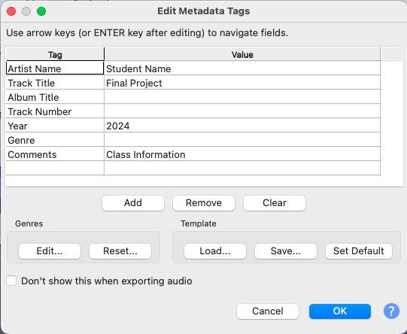
Exporting Metadata Tagging
When you export your file, Audacity will prompt you to add metadata tags to identify it.
Feel free to ask questions at any point during the presentation!

Slide 46
Thank you!
—Developed by Dipa Desai, Claire Lavarreda, Sara Morrell, and Avery Blankenship, Mel Williams, and Shannon Peifer
For more information on the DITI, please see: https://bit.ly/diti-about
Schedule an appointment with us! https://bit.ly/diti-meeting
If you have any questions, contact us at: nulab.info@gmail.com
We'd love your feedback! Please fill out a short survey here: https://bit.ly/diti-feedback

